Slide 1
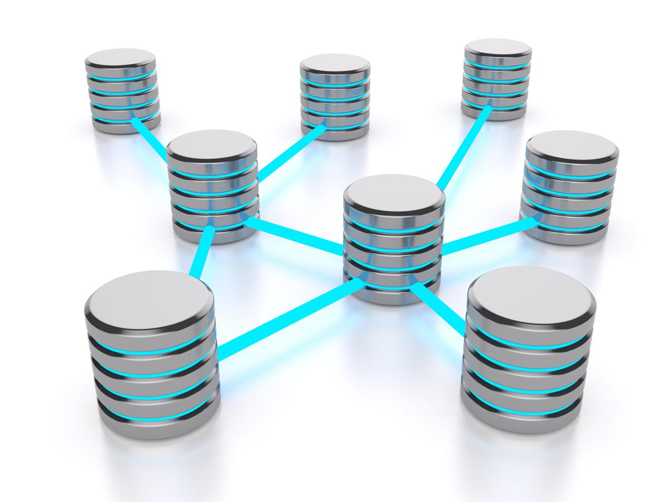
Chapter one
Introduction to Database Systems

Slide 2

Chapter one contents
1.1 - Introduction to Database Systems
1.2 - Three levels of Data Management
1.3 _ Roles in Database Design and Use
1.4 _ The ANSI-SPARC Architecture
1.5 - Functions of DBMS
1.6 – Database Languages (DDL, DML,DCL)
1.7 – Data Model

Slide 3
1.1 - Introduction to Database Systems
To find out what database is, we have to start from data, which is the basic building block of any DBMS.
What is “Data”?
Data can be defined as a representation of raw facts, concepts, or instructions in a formalized manner, which should be suitable for communication, interpretation or processing by human/electronic machine.
Data is represented with the help of characters such as alphabets (A-Z, a-z), digits (0-9) or special characters (+,-,/,*,<,>,= etc.)

Slide 4
Cont…
What is “Database System”?
Database is an organized collection of structured information, or data, typically stored electronically in a computer system.
Database is a collection of related data organized in a way that data can be easily accessed, managed, updated and controlled by DBMS.
Or, Database is a collection of inter-related data which helps in efficient retrieval, insertion and deletion of data from database and organizes the data in the form of tables, views, schemas etc.
Today, Databases are essential to every business. They are used to maintain internal records, to present data to customers and clients on the World-Wide-Web, and to support many other commercial processes.

Slide 5
Cont…
For example, you can consider, university database organizes the data about students, faculty, and admin staff etc. which helps in efficient retrieval, insertion and deletion of data from it.
You may have recorded these data in an indexed book or stored in a hard disk of a computer with help of some software's like MS-Excel or MS-Access.
So, this collection of related data with an implicit meaning is a database.
Note:- DBMS (Database Management System) is a software (a collection of programs) that enables users to create and maintain the database.

Slide 6
1.2 - Three levels of Data Management
Data management passes through the different levels of development along with the development in technology and services.
The major three levels are;
1. Manual Approach
2. Traditional File Based Approach
3. Database Approach

Slide 7
Cont…
Manual Approach
It refers to data processing that requires humans to manage and process the data throughout its existence.
Here, data storage and retrieval follows the primitive and traditional way of information handling where cards and paper are used for the purpose.
The data storage and retrieval is being done using human labor.
Many Files for as many event and objects as the organization has, since files are used to store information.
Each of the files containing various kinds of information is labelled and stored in one ore more cabinets.

Slide 8
Cont…
The cabinets could be kept in safe places for security purpose based on the sensitivity of the information contained in it.
Insertion and retrieval is done by searching first for the right cabinet then for the right file then the information. One could have an indexing system to facilitate access to the data.
For Example:- Cards and papers, Library catalog cards, hospitals/clinics cards, Kebele files.

Slide 9
Cont…
Limitations of the Manual Approach
      Prone to error
      Difficult to update, retrieve, integrate
      You have the data but it is difficult to compile the information
      Limited to small size information
      Cross referencing is difficult

Slide 10
Cont…
Traditional File Based Approach
Still computer applications with file based processing used for data handling.
  File based systems were an early attempt to computerize the manual filing system.
  It is basically a way of arranging the files in a storage medium like a hard disk.
  This approach is the decentralized computerized data handling method. A collection of application programs perform services for the end-users.
  In such systems, every application program that provides service to end users define and manage its own data.

Slide 11
Cont…
  Such systems have number of programs for each of the different applications in the organization.
  Since every application defines and manages its own data, the system is subjected to serious data duplication problem.
  File, in traditional file based approach, is a collection of records, which contains logically related data.

Slide 12
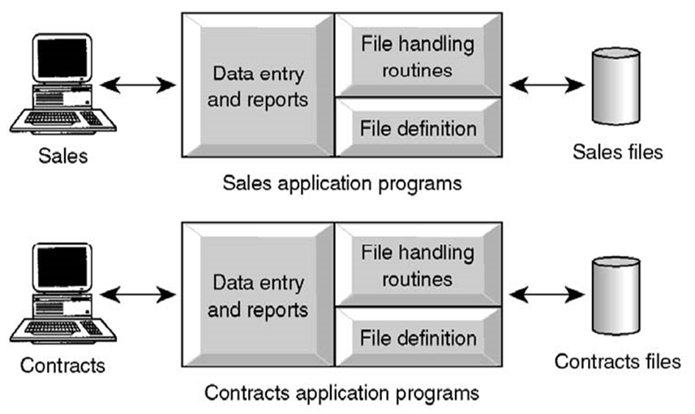
Cont…

Slide 13
Cont…
Limitations of the Traditional File Based approach
      Separation or Isolation of Data: Available information in one application may not be known.
      Limited data sharing
      Lengthy development and maintenance time
      Duplication or redundancy of data
      Data dependency on the application
      Incompatible file formats between different applications and programs creating inconsistency.
      Fixed query processing which defined during application development

Slide 14
Cont…
  The most significant problem experienced by the traditional file based approach of data handling is the “update anomalies”.
  We have three types of update anomalies;
    Modification Anomalies: a problem experienced when one or more data value is modified on one application program but not on others containing the same data set.
    Deletion Anomalies: a problem encountered where one record set is deleted from one application but remain untouched in other application programs.

Slide 15
Cont…
    Insertion Anomalies: a problem experienced whenever there is new data item to be recorded, and the recording is not made in all the applications.

Slide 16
Cont…
Database Approach
  Database is just a computerized record keeping system or a kind of electronic filing cabinet.
  Database is a shared collection of logically related data designed to meet the information needs of an organization.
  The database approach emphasizes the integration and sharing of data throughout the organization.
  Since it is a shared corporate resource, the database is integrated with minimum amount of or no duplication.

Slide 17
Cont…
  Database is a collection of logically related data where these logically related data comprises entities, attributes, relationships, and business rules of an organization's information.
  In addition to containing data required by an organization, database also contains a description of the data, which called as “Metadata” or “Data Dictionary” or “Systems Catalogue”, or “Data about Data”.
  Since a database contains information about the data (metadata), it is called a self-descriptive collection on integrated records.
  The purpose of a database is to store information and to allow users to retrieve and update that information on demand.

Slide 18
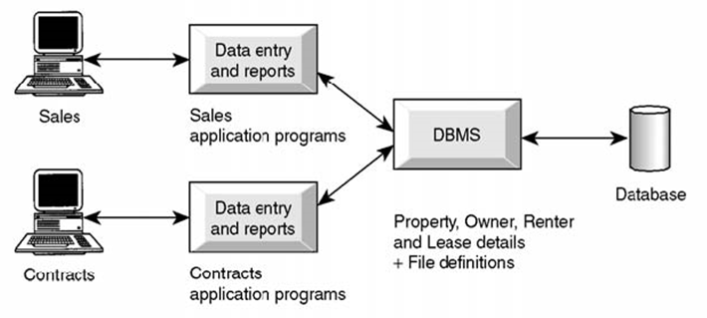

Cont…
  Database is deigned once and used simultaneously by many users.
  Unlike the traditional file based approach, in database approach there is program data independence. That is the separation of the data definition from the application. Thus the application is not affected by changes made in the data structure and file organization.
  Each database application will perform the combination of creating database, Reading, Updating and Deleting data.

Slide 19
Cont…
Some of the benefits of the database approach
  Data can be shared: two or more users can access and use same data instead of storing data in redundant manner for each user.
Improved accessibility of data: by using structured query languages, the users can easily access data without programming experience.
Redundancy can be reduced: isolated data is integrated in database to decrease the redundant data stored at different applications.
Speed: data storage and retrieval is fast, as it will be using modern fast computer systems.

Slide 20
Cont…
Integrity can be maintained: data at d/t applications will be integrated together with additional constraints to facilitate shared data resource.
  Security majors can be enforced: the shared data can be secured by having different levels of clearance and other data security mechanisms.
Compactness: since it is an electronic data handling method, the data is stored compactly (no voluminous papers).
Less labor: unlike the other data handling methods, data maintenance will not demand much resource.
Centralized information control: since relevant data in the organization will be stored at one repository, it can be controlled and managed at the central level.

Slide 21
Cont…
Limitations and risk of Database Approach
    Introduction of new professional and specialized personnel.
    Complexity in designing and managing data
    The cost and risk during conversion from the old to the new system
    High cost to be incurred to develop and maintain the system
    Complex backup and recover services from the users perspective
    Reduced performance due to centralization and data independency
    High impact on the system when failure occurs to the central system.

Slide 22
Difference between File System and DBMS
Basis | File System | DBMS
Structure | file system is software that manages and organizes files in a storage medium within a computer. | DBMS is software for managing the database.
Data Redundancy | Redundant data can be present in a file system. | In DBMS there is no redundant data.
Backup and Recovery | It doesn’t provide backup and recovery of data if it is lost. | It provides backup and recovery of data even if it is lost.
Query processing | There is no efficient query processing in the file system. | Efficient query processing is there in DBMS.
Data Independence | There is no data independence. | In DBMS data independence exists.

Slide 23
Cont…
Cost | It is less expensive than DBMS. | It has a comparatively higher cost than a file system.
Consistency | There is less data consistency in the file system. | There is more data consistency because of the process of normalization.
Complexity | It is less complex as compared to DBMS. | It has more complexity in handling as compared to the file system.
Security Constraints | File systems provide less security in comparison to DBMS. | DBMS has more security mechanisms as compared to file systems.
User Access | Only one user can access data at a time. | Multiple users can access data at a time.

Slide 24
Components of DBMS Environment
Basically, DBMS environment has five components.
  1. Hardware: like personal computers, mainframe or any server computers, network infrastructure, and other peripherals required in the system.
  2. Software: include DBMS software, application programs, operating systems, network software, language software and other relevant software.
  3. Procedure: is the rules and regulations on how to design and use a database.

Slide 25
Cont…
  4. Data is the most important component to the user of the database.
    Operational data is the data actually stored in the system to be used by the user.
    Metadata is the data that is used to store information about the database itself.
  5. People: play a role in designing, implementing, managing, administering and using the resources in the database.

Slide 26
1.3 Roles in Database Design and Development
There are group of roles played by different stakeholders of the designing and operation of a database system.
  DataBase Administrator (DBA)
      Responsible to oversee, control and manage the database resources
      Authorizing access to the database
      Coordinating and monitoring the use of the database
      Responsible for determining and acquiring hardware and software resources
      Accountable for problems like poor security, poor performance of system
      Involves in all steps of database development

Slide 27
Cont…
  Database Designer (DBD)
      Identifies the data to be stored and choose the appropriate structures to represent and store the data.
      Should understand the user requirement and should choose how the user views the database.
      Involve on the design phase before the implementation of the database system.

Slide 28
Cont…
  Systems Analyst and Application Programmer
    It determines the user requirement and how the user wants to view the database.
    Also determine the requirements of end users, especially naive users, and develop specifications for canned transactions that meet these requirements.
    The application programmer implements these specifications as programs; code, test, debug, document and maintain application program.
    Determines the interface on how to retrieve, insert, update and delete data in the database.
    The application could use any high level programming language according to the availability, the facility and the required service.

Slide 29
Cont…
  End Users
  Workers, whose job requires accessing the database frequently for various purpose.
  There are different group of users in this category.
  a. Naïve Users:
          Only access the database based on their access level and demand
          Use standard and pre-specified types of queries.
          their main job function revolves around constantly querying and updating the database, using standard types of queries and updates called canned transactions that have been carefully programmed and tested.

Slide 30
Cont…
  b. Sophisticated Users
    Are users familiar with the structure of the Database and facilities of DBMS.
    Have complex requirements and higher level queries
    Include engineers, scientists, business analysts who try to learn most of the DBMS facilities in order to achieve their complex requirements
    C. Casual Users
          Users who access the database occasionally.
          Need different information from the database each time.
          Use sophisticated database queries to satisfy their needs.

Slide 31
1.4 – The ANSI SPARC Database Architecture
The Architecture of most of commercial DBMS are available today is mostly based on this ANSI-SPARC database architecture .
ANSI SPARC THREE-TIER architecture has main three levels:
  Internal Level
  Conceptual Level
  External Level
These three levels provide data abstraction ;means hide the low level complexities from end users.
A database system should be efficient in performance and convenient in use.
Using these three levels, it is possible to use complex structures at internal level for efficient operations and to provide simpler convenient interface at external level.
Notes:
A Database Management system is not always directly available for users and applications to access and store data in it.

Slide 32
Cont.…
Internal Level
  This is the lowest level of data abstraction.
  It describes How the data are actually stored on storage devices.
  It is also known as physical level.
  It provides internal view of physical storage of data.
  It deals with complex low level data structures, file structures and access methods in detail.
Notes:
A Database Management system is not always directly available for users and applications to access and store data in it.

Slide 33
Cont.…
2. Conceptual level:
  This is the next higher level than internal level of data abstraction.
  It describes What data are stored in the database and What relationships exist among those data.
  It is also known as Logical level.
  It hides low level complexities of physical storage.
  Database administrator and designers work at this level to determine What data to keep in database.
  Application developers also work on this level.
Notes:
A Database Management system is not always directly available for users and applications to access and store data in it.

Slide 34
Cont.…
3. External Level:
  This is the highest level of data abstraction.
  It describes only part of the entire database that a end user concern.
  It is also known as view level.
  End users need to access only part of the database rather than entire database.
  Different user need different views of database. And so, there can be many view level abstractions of the same database
Notes:
A Database Management system is not always directly available for users and applications to access and store data in it.

Slide 35
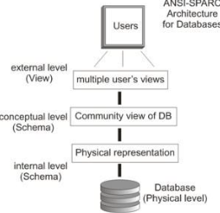
Diagram For ANSI SPARC Database Architecture
Notes:
A Database Management system is not always directly available for users and applications to access and store data in it.

Slide 36

Cont.…
Advantages of ANSI SPARC DB Architecture
The main objective of it is to provide data abstraction.
Same data can be accessed by different users with d/t customized views.
The user is not concerned about the physical data storage details.
Physical storage structure can be changed without requiring changes in conceptual structure of the database as well as users view called Physical data independence.
Conceptual structure of the database can be changed without affecting end users called Logical data independence.
Notes:
A Database Management system is not always directly available for users and applications to access and store data in it.

Slide 37
1.5 – Functions of DBMS
DBMS is a software or a collection of programs that enable users to create and maintain the database.
It serves as an interface between an end-user and a database, allowing users to create, store, retrieve, and update data in a database.
DBMS also provides the service of controlling data access, enforcing data integrity, managing concurrency control, and recovery.
  A DBMS is software package used to design, manage, and maintain databases.
  Each DBMS should have facilities to define the database, manipulate the content of the database and control the database.

Slide 38
Cont.…
These facilities will help the designer, the user and database administrator to discharge their responsibility in designing, using and managing the database.
Functionalities:-
  Define:- Specifying the data type, structure and constraints for the data to be stored.
  Construct:- Process of storing data on some storing medium (storage of data).
  Manipulate:- Querying the database to retrieve specific data, updating database and generating reports.
  Share:- Allows multiple users and programs to access the database concurrently.

Slide 39
1.6 Database Languages
DBMS provides the following Database Languages:
  Data Definition Language (DDL):
    It used to define each data element required by the organization.
    Commands for setting up schema or the intension of database
    These commands are used to setup a database, create, delete and alter table with the facility of handling constraints
    Example, create table, alter table are instruction in SQL

Slide 40
Cont…
  Data Manipulation Language (DML):
    It is a core command used by end-users and programmers to store, retrieve, and access the data in the database e.g. insert, update, delete are instructions in SQL
    Since the required data or Query by the user will be extracted using this type of language, it is also called "Query Language"
  Data Control Language:
    Data Control Languages are commands that will help the Database Administrator to control the overall operations of the database.

Slide 41
Cont…
    The commands include grant or revoke privileges to access the database or particular object within the database and to store or remove database transactions.
  Data Dictionary:
    Because a database is a self-describing system, this tool, Data Dictionary, is used to store and organize information about the data stored in the database.

Slide 42
Cont.…
E. Storage Definition Language (SDL):-is used to specify the internal schema.
F. View Definition Language (VDL):- is needed to specify user views and their mappings to the conceptual schema.
The current DBMSs, a comprehensive integrated language called the SQL relational database language represents a combination of DDL, VDL, DCL, DML and some features also.
Here are some examples of popular DBMS used these days: MySQL, MS SQL Server, PostgreSQL, IBM DB2, oracle, Amazon SimpleDB (cloud based) etc.

Slide 43
1.7 – Data Model
What is “Data Model”?
It is a set of concepts to describe the structure of a database, and to define how data will be stored, accessed and updated in a database.
It is also a collection of concepts that can be used to describe the structure of a database to achieve the data abstraction.
The structure of a database means the data types, relationships, and constraints that should hold for the data.
It helps to understand the relationship between entities and to create the most effective structure to hold data.
Categories of data models include
    Record-based
    Object-based
    Physical-based

Slide 44
Cont…
Record-based database model
It consist of a number of fixed format records.
Each record type defines a fixed number of fields,
Each field is typically of a fixed length.
Types of record based data model
  Hierarchical Database Model
  Network Database Model
  Relational Database Model

Slide 45
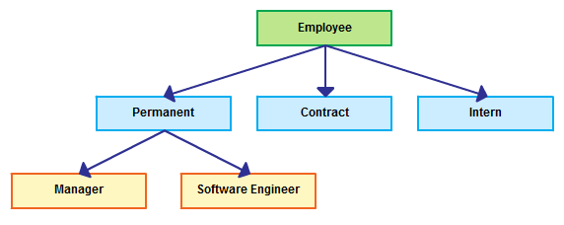
Hierarchical Model
The simplest data model.
Organized data in tree like structure.
And Record type is referred to as nodes or segments and the top node is the root node.
Nodes are arranged in a hierarchical.
A parent node can have more than one
child node .
A child node can only have one parent node.
The relationship between parent and child
is one-to-many

Slide 46
Cont.…
Advantages
Disadvantages
Hierarchical Model is simple to construct and operate on.
It allows fast and efficient searches on the data it contains, due to the fact that the path to all data in the model is unique.
Database is visualized as a linear arrangement of records
Complex to implement- Requires knowledge of physical level of storage.
Difficult to manage, not very flexible.
Multiple parent conditions occur in real world.

Slide 47
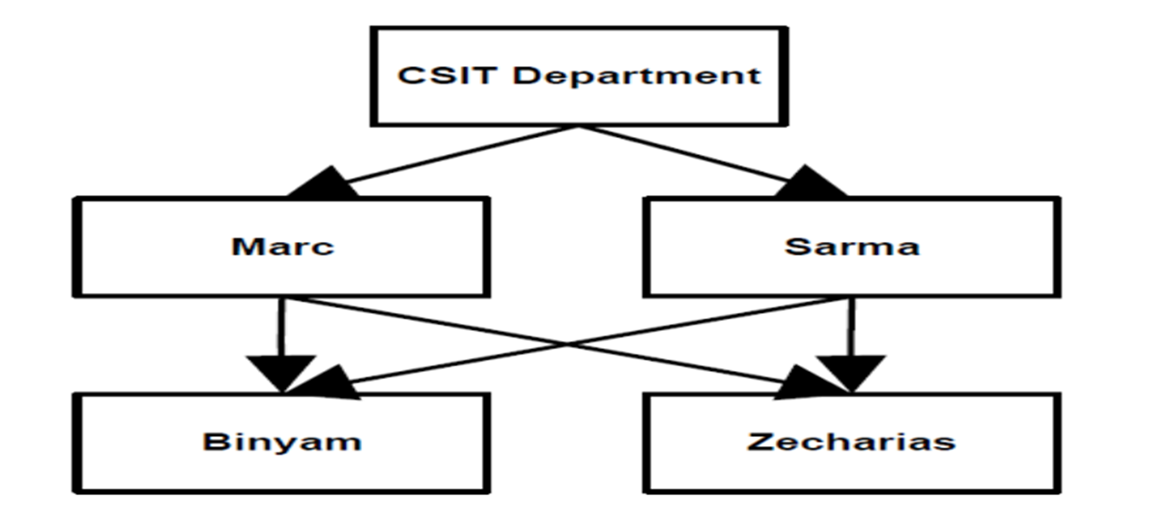
2. Network Model
Like hierarchical model, network model is a collection of physically linked records.
In this model data is organised more like a graph, and are allowed to have more than one parent node.
Resembles hierarchical model but allows record types to have more than one parent.
This database model was used to map many-to-many data relationships.
This was the most widely used database model, before Relational Model was introduced.

Slide 48
Cont.…
Advantages
Disadvantages
Network Model is able to represent complex relationships
Improved database performance.
More flexible and better data access method than hierarchical.
Heavy pressure on programmers.
Complex structure from program point of view.
Difficult to design and use because in-depth understanding of structure is needed.

Slide 49
3. Relational Data Model
Now the relational model is the dominant model for commercial data processing applications.
Can define more flexible and complex relationship.
A relational database consists of a collection of tables, each having a unique name.
Order of rows and columns is immaterial.
Entries with repeating groups are said to be un-normalized.
A row in a table represents a relationship among a set of values.

Slide 50
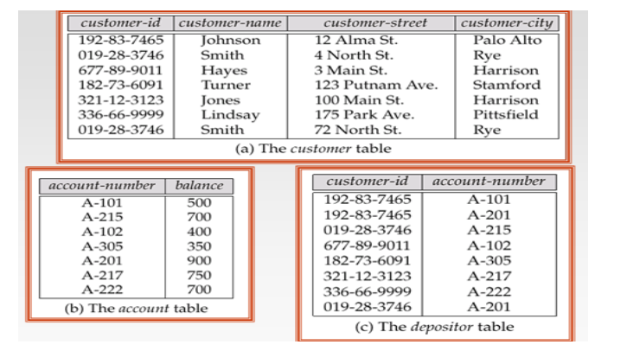
Cont.…
A sample relational database is given below.

Slide 51
Cont…
Its Strengths
It is simple to understand.
It is highly flexible and easy to use (all types of relationships are possible, and accessing data is done using a standard language, SQL).
Its Weaknesses
Search and access times are relatively slow
Note:- we will discuss detail on the next chapter.

Slide 52
Thank you!!

